Slide 1
Review Analysis
By James Weber

Slide 2
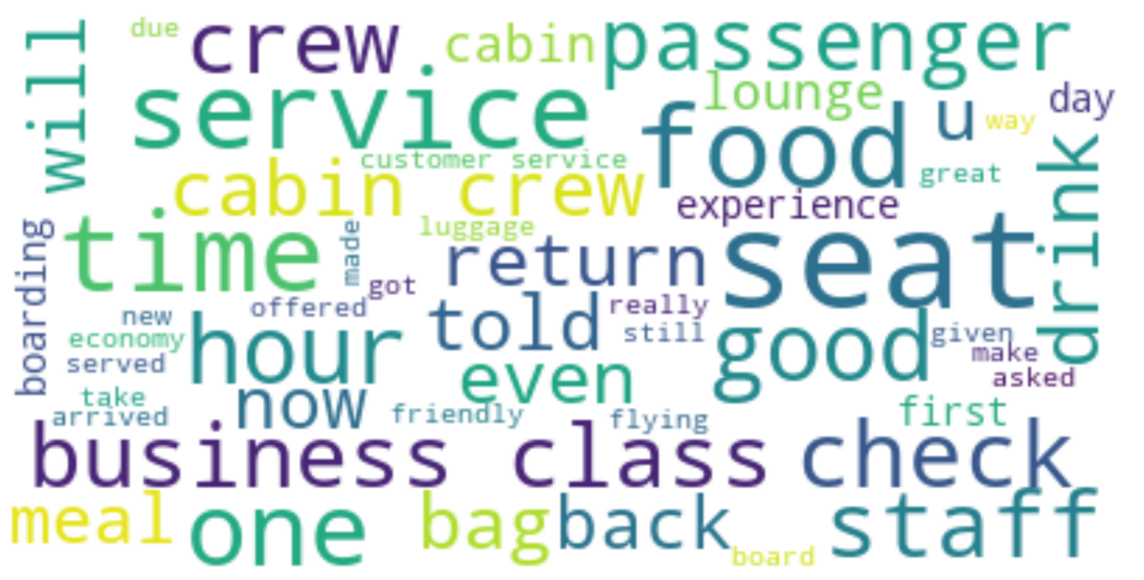
Insights on Analysis
Analysis was conducted on 3126 reviews regarding the British Airways airline, posted on Skytrax.
Average Trip Rating
Solo Leisure Passengers: 4.96
Business Passengers: 3.46
All other categories, solo leisure passengers rate the highest, business passengers rate the lowest.
Sentiment analysis:
Positive Reviews: 49.81%
Negative Reviews: 43.31%
Neutral Reviews: 6.88%
The largest words in the word cloud pertain to customer’s time, comfort, and service.
Notes:
An analysis was conducted on 3126 reviews regarding the British Airways airline, posted on Skytrax.
The average rating was calculated, grouped by passenger type.
Four passenger types were identified: Solo Leisure Passengers, Couple Leisure Passengers, Family Leisure Passengers, and Business Passengers.
Of the four passenger types, the Solo Leisure Passengers rated their experience the highest with an average rating of 4.96 out of 10.
Business passengers rated their experience the lowest with an average rating of 3.46 out of 10.
This pattern is repeated with other metrics which include seat comfort, staff service, foods and drinks, ground service, and value for the money.
Solo leisure passengers rated all categories the highest while business passengers rated all categories the lowest.
The sentiment analysis categorizes reviews as positive, neutral, or negative.
49.81% of reviews are considered positive, 43.31% are considered negative, and 6.88% are considered neutral.
The word cloud depicted shows the 50 most used words in the reviews with larger words being used more often.
The largest words in the word cloud pertain to passenger’s comfort, passenger’s time, and service provided.
These words include "seat", "food", “time", "service", "hour", “check", "staff“ and “business class".
To raise the average rating of the airline, focus should be made in improving seat comfort, cabin and ground service, and food and drink quality.
More focus should be placed on improving business class than other classes.
Business class make up 21.4% of total reviews, and customers in business class consistently rate their experience the lowest.

